Slide 1
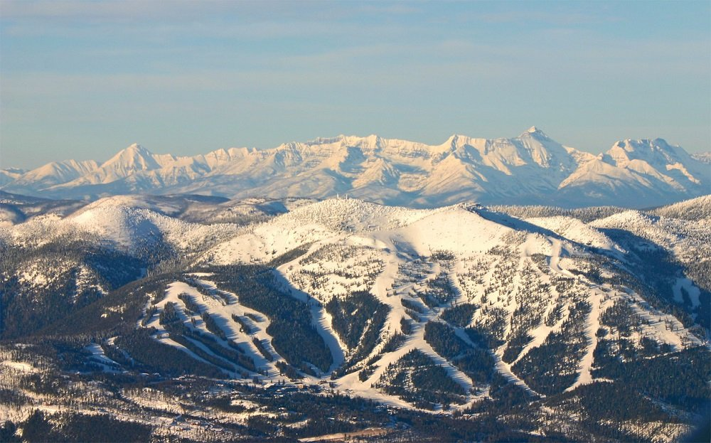
Big Mountain Resort:
Our time to shine

Slide 2
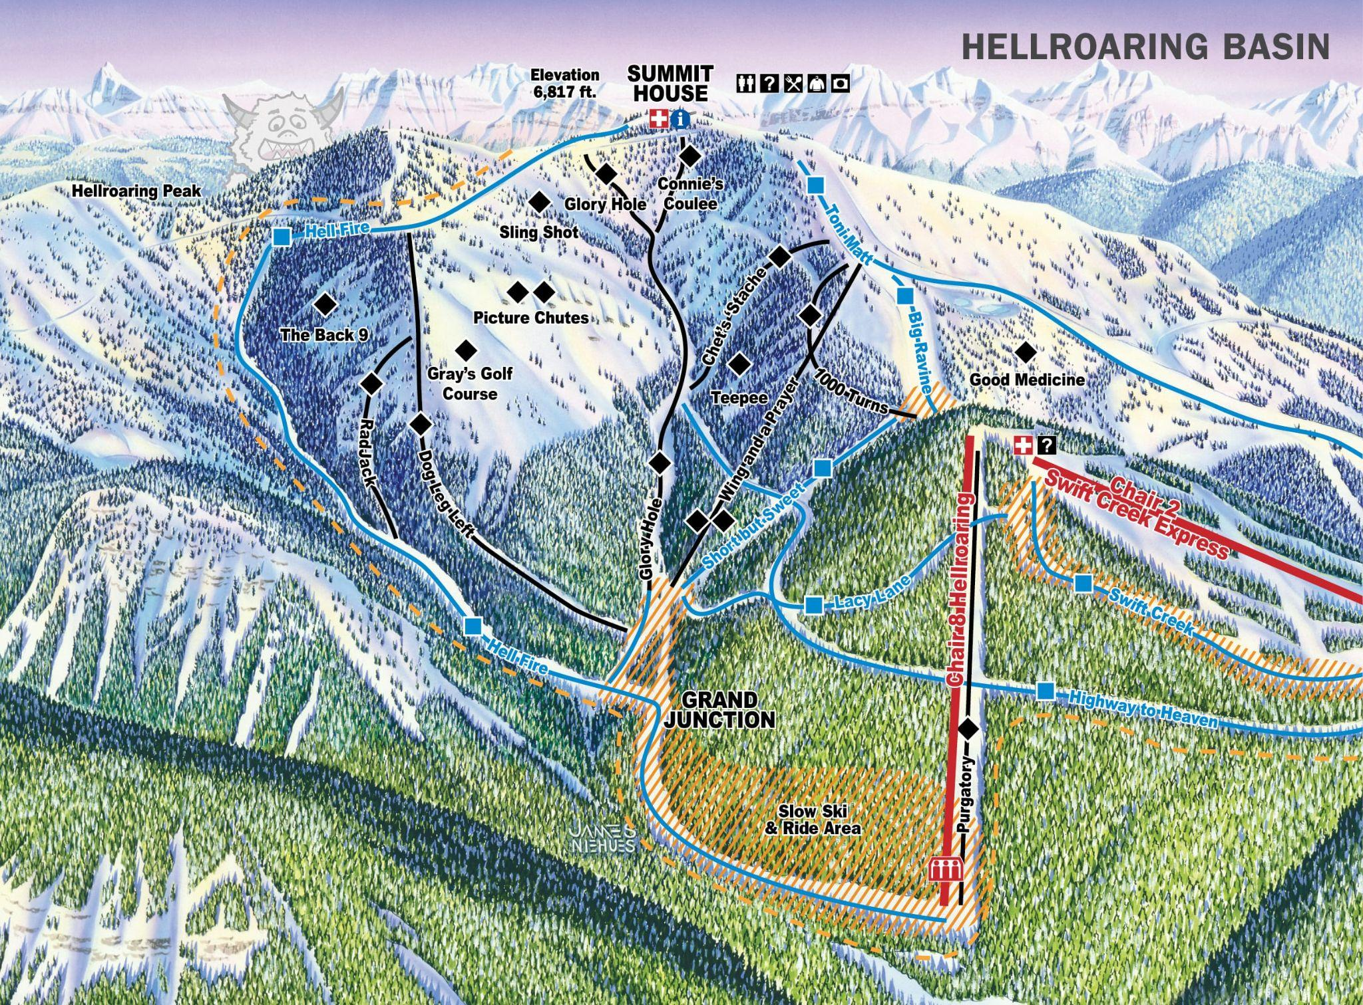
How “Big” is Big Mountain
Serving Montana and its visitors for over 72 years.
350,000 guests accommodated annually.
14 different lifting chairs and 105 runs. The longest run stretches approximately 3.3 miles(Hellfire).
One of the top resorts in skiable area and snow making.
Notes:
Before moving forward, we need to look back at the integrity of our resort. We must to be proud of this resort, and most importantly we must provide what it deserves.

Slide 3
“Know who you are. Know what you want. Know what you deserve. And don’t settle for less.” -Tony Gaskins
Are we capitalizing on our facilities as much as we could?
Is following the market average price the smartest decision?
How much can we increase our profit by while covering the operation cost and still accommodate our numerous guests and keep them satisfied?
How much should Big Mountain actually charge for its tickets?
Notes:
So, how much should we charge for our tickets? We are already one of the most expensive resorts in Montana, but is that the right measure? We want to charge what we are worth so we have to envision a bigger picture. Keeping our facilities appealing and attractive would justify our price increase, hence, other resorts charge a lot more and accommodate a lot more people, with sometimes similar if not less machinery and qualities. But the big question remains, How much exactly should we charge? Should we base it on the national average? Or should we dig deeper into our data and figure out the trends.

Slide 4
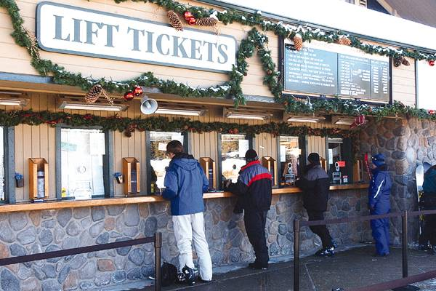
The Right Path Forward
The suggestion:
Current price: $81
Suggested price: $95.87
Expected mean error: $10.39
Adding an additional chair and extending the longest run would benefit the resort by allowing a bigger margin for the price increase.
Key findings along the way:
The state/region has no influence in our model’s prediction.
Vertical drop and the numbers of lifting chairs have a strong correlation with the ticket price.
Random Forest Model was the model that performed the best with the given data.
More data such as operation cost and average income by state would help us build a stronger model.
Notes:
After a careful and thorough analysis of the data provided, we built a strong arithmetic model to predict the price our resort DESERVES. Our model suggested an increase of approximately 14 dollars, bringing the price to almost $96. Yes 96 dollars! Of course there is a 10.39 error margin, however, our model is strongly approving of a major increase in price. During this project we came across multiple features, some of which we completely removed while other that we thought had less importance turned out to be the most influential ones.

Slide 5
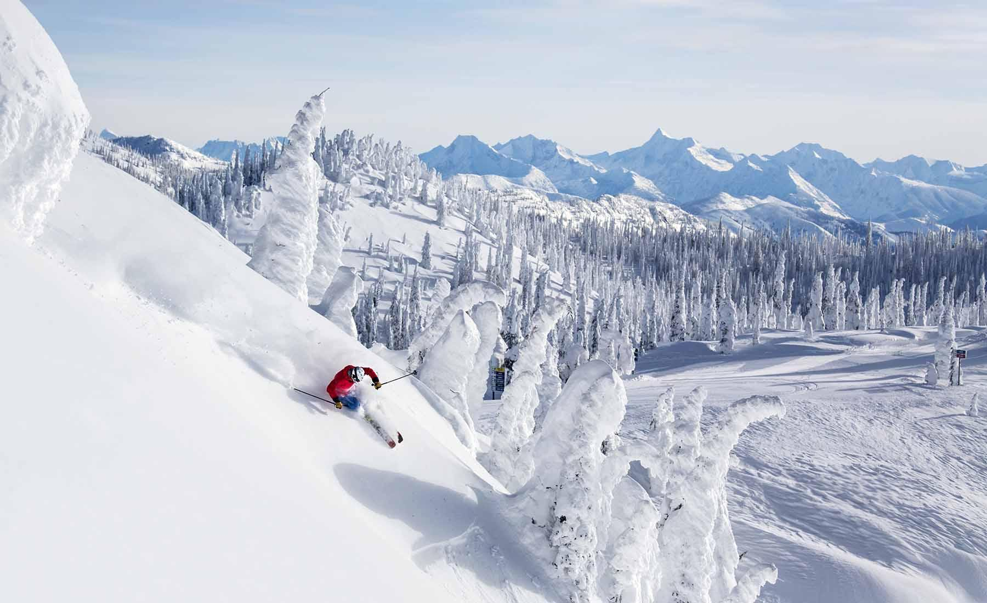
Explaining our Findings
Notes:
We will dig deeper into our findings and why the price must be changed!

Slide 6
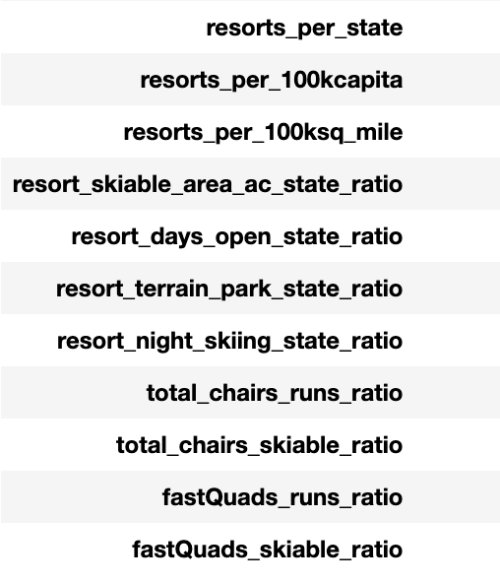
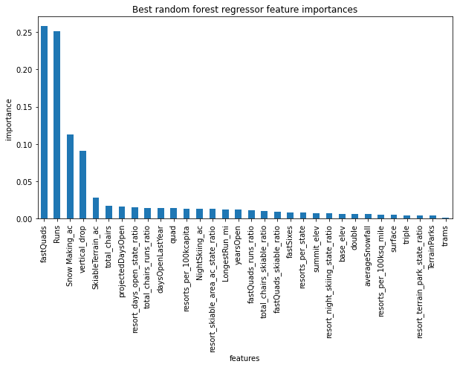
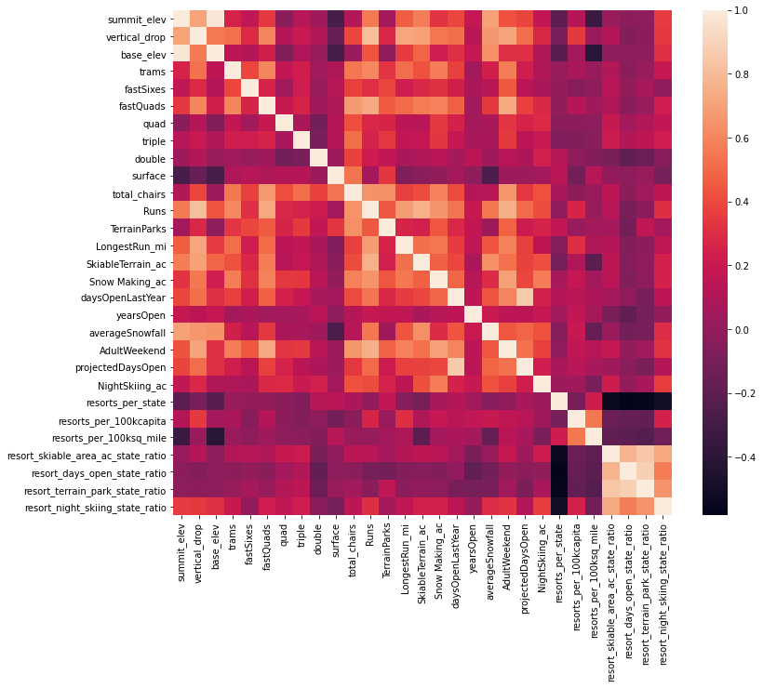
What matters the most when deciding our pricing strategy?
Created new features to using additional geographic and demographic state statistics.
Building a heat map of the correlation of all our features to locate any trends. This graph was a great guidance on our path to finding the our main features.
Our Random Forest model helped us build a bar plot of the most influential features.
After all the tests and analysis, we concluded that the following features are the most important:
vertical_drop
Snow Making_ac
total_chairs
fastQuads
Runs
LongestRun_mi
trams
SkiableTerrain_ac
Notes:
While cleaning and preparing our data we not only deleted few features but also created new ones as the list shows. The features helped us understand the situation better and guided us in the right direction. All those density features might not have been the most influential to the price, but they helped us eliminate such as the geographical location, which we thought was going to play a major role in our model. This heat map is such a simple and beautiful representation of the relationships between all our features. The lighter the color is the more correlation there is between the features. Once we picked the Random Forest model as our preferred one, we then created a bar graph to represent the importance of each feature in our model, which portrayed a pattern in the most influential features. A pattern that we suspected while preparing our data and also trying different models (a linear model in our case).

Slide 7
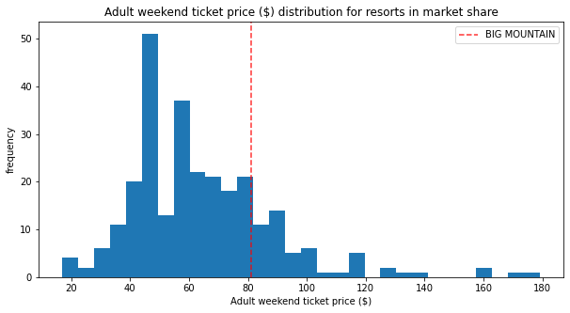
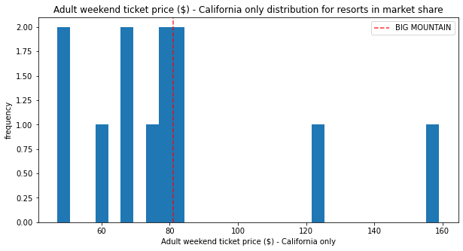
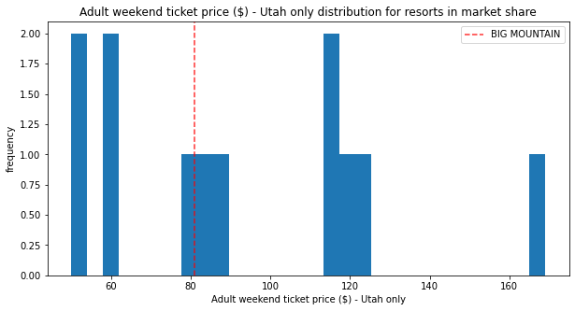
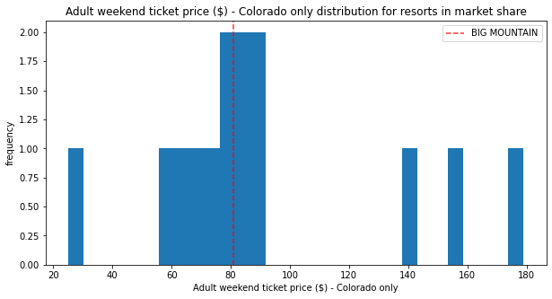
Our Pricing
Only charging $81 dollars, Big Mountain figures among the most expensive resorts in the nation.
Where we stand in comparison to the biggest skiing destinations:
Notes:
Where are we in the pricing map? Yes, most of us know we are at the top in Montana, but where do we stand in the market? Big Mountain is figures among the 20% most expensive resorts in America. However, our goal here is not to base the price on what all the other resorts charge. Our goal today is to compete with among the big resorts. We can see in the first graph where we stand in the nation. On the other graphs, I decided to portray that we are underestimating our resort. We are clearly qualified for a raise in our price. One would say that these other resorts possess facilities and qualities that we don’t, well the next slide will clear that out.

Slide 8
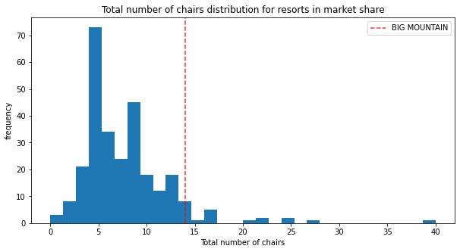
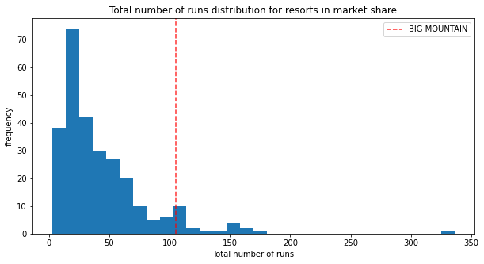
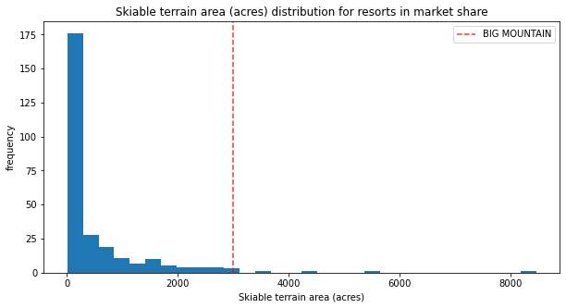
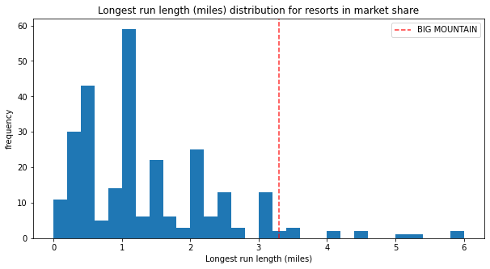
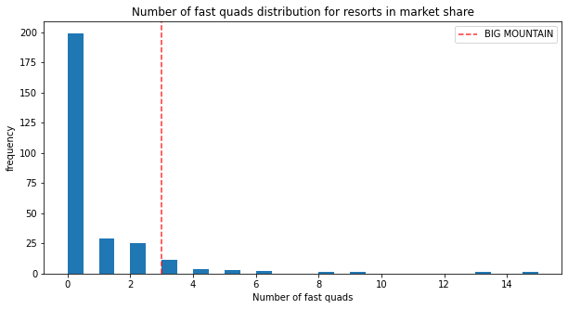
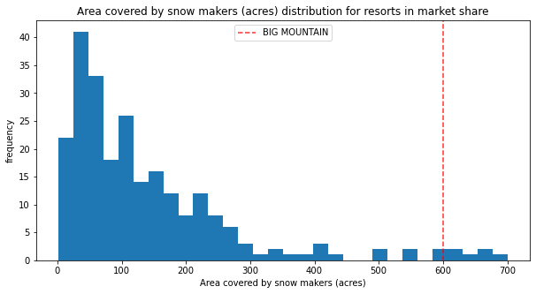
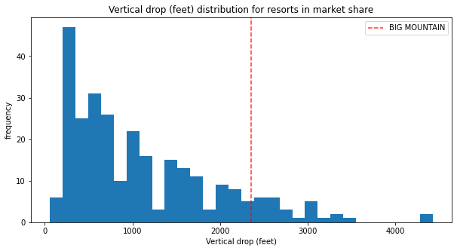
We are worth it!
Notes:
“A picture is worth a thousand words”. Before digging into the details of these graphs, if you observe the red line, you will see that it is always skewed to the right of the graph, meaning it is always part of the best. Well, that line is Big Mountain. We are indeed one of the best so we shall charge like the best. The number of chairs, and especially the fast quads, are one of the main facilities every customer looks forward to. The faster you move around the resort, the more you skii. Additionally, the vertical drop is an attraction itself. Customers love to tell their friends they went to a resort with a high vertical drop, which is something we don’t lack of overhere. We make more snow! We have more snow to ski on! We also have multiple runs to choose from along with one of the longest runs!

Slide 9
“Render unto Cæser that which is Cæser’s”
New pricing strategy in order to add value to the resort and increase its profit.
Our model could be used to determine how a change in the facilities could help increase or lower the price.
Notes:
In conclusion, I strongly recommend a revisit of the pricing strategies. An increase sounds logical without exploring any scenarios or technics. What we have is already enough to claim what we deserve. In addition, we can explore multiple scenarios regarding adding more chairs or extending our vertical drop, just using our model. Big Mountain is overdue for a ticket price increase, so I hope this model will help you give it what it deserves.

